Slide 1
End Node Schematics
By Souvik Halder

Slide 2

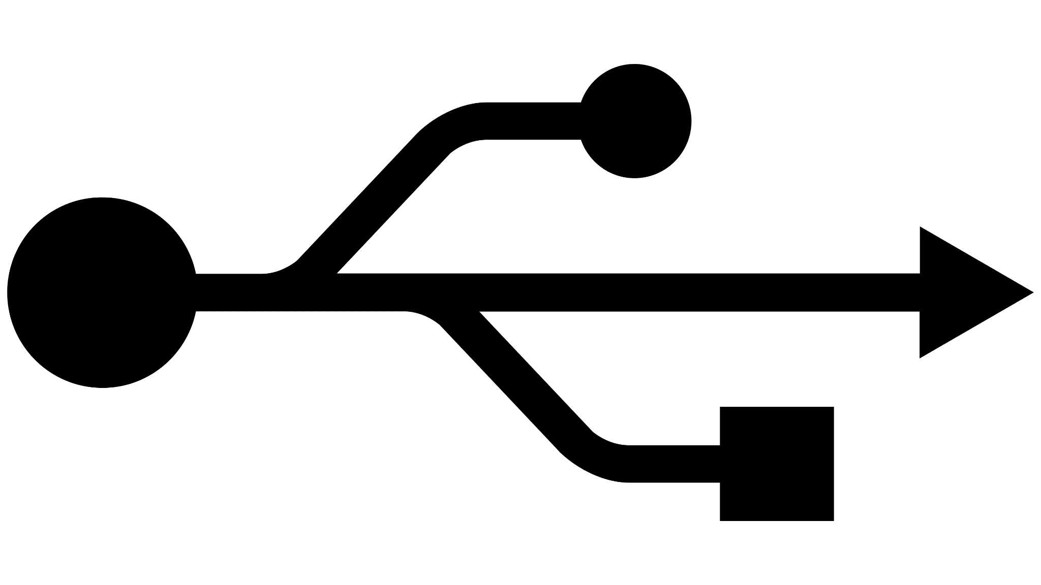
END NODE BLOCK DIAGRAM
EEPROM
2MB
RF transceiver - LR1120
SPI(4), BUSY
QSPI(I/O(4), nCS, SCK )
FLASH
32MB
I2C(2)
LR1120 RF ANTENNA
32.867KHz
32MHz
32.867KHz
UART DEBUGGING
JTAG(5)
JTAG
CLOCK
BLOCK
16MHz,
FREQ/2
LR1120 RF TRANSCEIVER VOLTAGE
USB
32MHz
MCU
USB(DM, DP)
GPS ANTENNA
UART(2), WAKEUP
STM32WB55CG
CORTEX M4
WITH BLE
SPI
SPI(4)
GPS SUPPLY(V_GPS)
GPS IC
GPIO : BERGSTRIPS(20)
GPIO
WATCHDOG
TIMER
APB1 BUS
MCU SUPPLY(V_MCU)
IRQ
HALL EFFECT
GPIO
POWER SUPPLY BLOCK
IMU SENSOR
I2C
GPIO
USER BUTTON

Slide 3
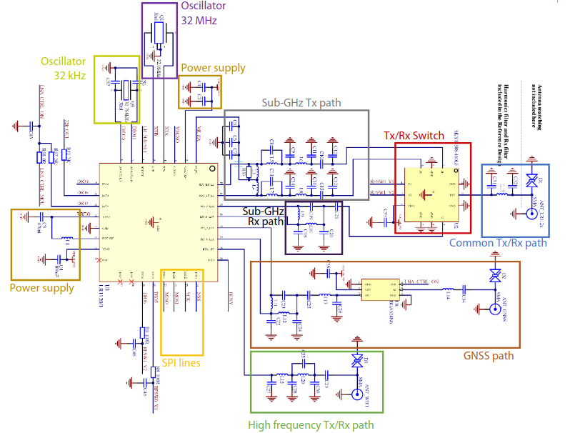
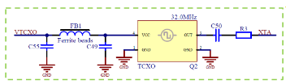

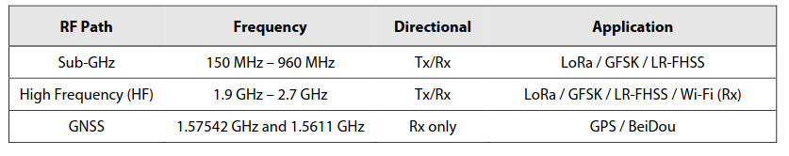
RF transceiver - LR1120
TCXO BLOCK
CLOCK SOURCE - TCXO BLOCK
Unused

Slide 4
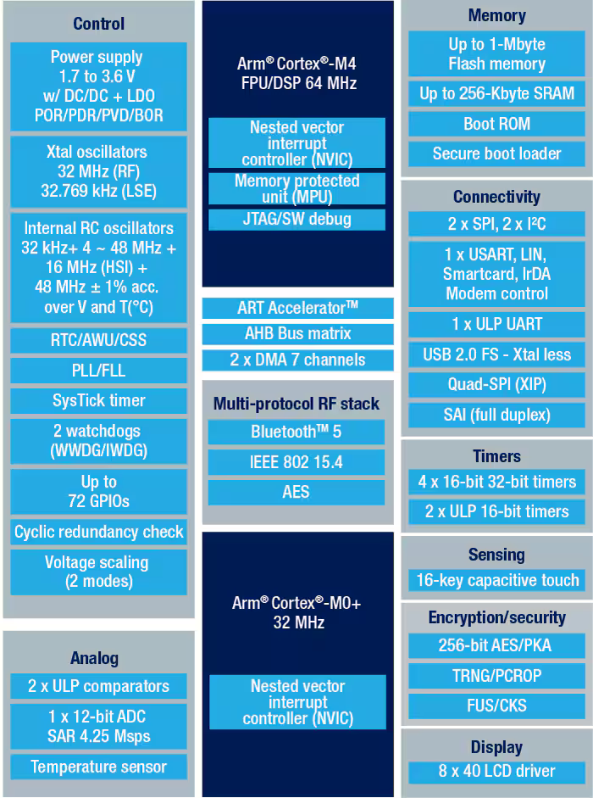
END NODE MCU SELECTION
STM32WB55CG:
Dual-core architecture: Features an Arm Cortex-M4 (application core) + Cortex-M0+ (network core), enabling clean separation between user app and wireless stack.
Built-in wireless: Native support for Bluetooth Low Energy (BLE 5.0/5.1) and IEEE 802.15.4 (Thread, Zigbee, proprietary).
Ultra-low power MCU: Optimized for battery-powered IoT with multiple low-power modes and very low sleep current.
Rich peripherals: Includes ADC, timers, SPI, I²C, USART, USB, RTC, DMA, and capacitive touch support.
Security features: Hardware cryptography (AES, PKA), secure boot, firmware upgrade, and TrustZone-like isolation via dual core.
Ideal for IoT nodes: Widely used in smart sensors, wearables, beacons, home automation, and industrial wireless nodes.

Slide 5
LoRa Transceiver, GPS, BLE
LoRa Transceiver : LR1120
Multi-band LoRa® transceiver: Supports sub-GHz and 2.4 GHz LoRa® RX/TX with ultra-low power operation, ideal for long-range, battery-powered IoT nodes.
LR-FHSS uplink support: Enables Long Range – Frequency Hopping Spread Spectrum for massive-scale networks, high capacity, and improved interference robustness.
Energy-efficient design: Very low RX current consumption with deep sleep modes, optimized for multi-year battery life in IoT deployments.
Advanced features for NTN & mobility: Supports Doppler tolerance, fine timestamping, and scalable data rates, making it suitable for LEO satellite (NTN) LoRaWAN use cases.
Tx power consumption can further be controlled using periodic uplinks and deep sleep with aid of LoRaWAN class B
GPS : Quectel L89
Multi-constellation GNSS: Supports NavIC (IRNSS) along with GPS, GLONASS, Galileo, and QZSS for improved positioning accuracy in India.
Low power operation: Optimized for battery-powered IoT devices with low tracking and acquisition power consumption and standby modes.
Simple host interface: UART interface with standard NMEA output, enabling easy integration with STM32-class microcontrollers.
Fast and accurate fixes: High-sensitivity receiver with quick TTFF (Time-To-First-Fix) and stable performance in weak-signal environments.
BLE : ST32WB55CG INBUILT
Dedicated BLE core: BLE runs on a separate Cortex-M0+ network core, keeping the Cortex-M4 free for application tasks (no RTOS conflicts).
BLE 5.x compliant: Supports Bluetooth Low Energy 5.0/5.1 features like extended advertising, higher data rate, and improved range.
Pre-certified BLE stack: Comes with ST-provided, qualified BLE stack, reducing certification effort and time-to-market.
Low-power BLE operation: Optimized radio and sleep modes enable very low current consumption, ideal for battery-powered IoT nodes.
Secure wireless communication: Hardware-based AES encryption, pairing, bonding, and secure firmware update over BLE.

Slide 6
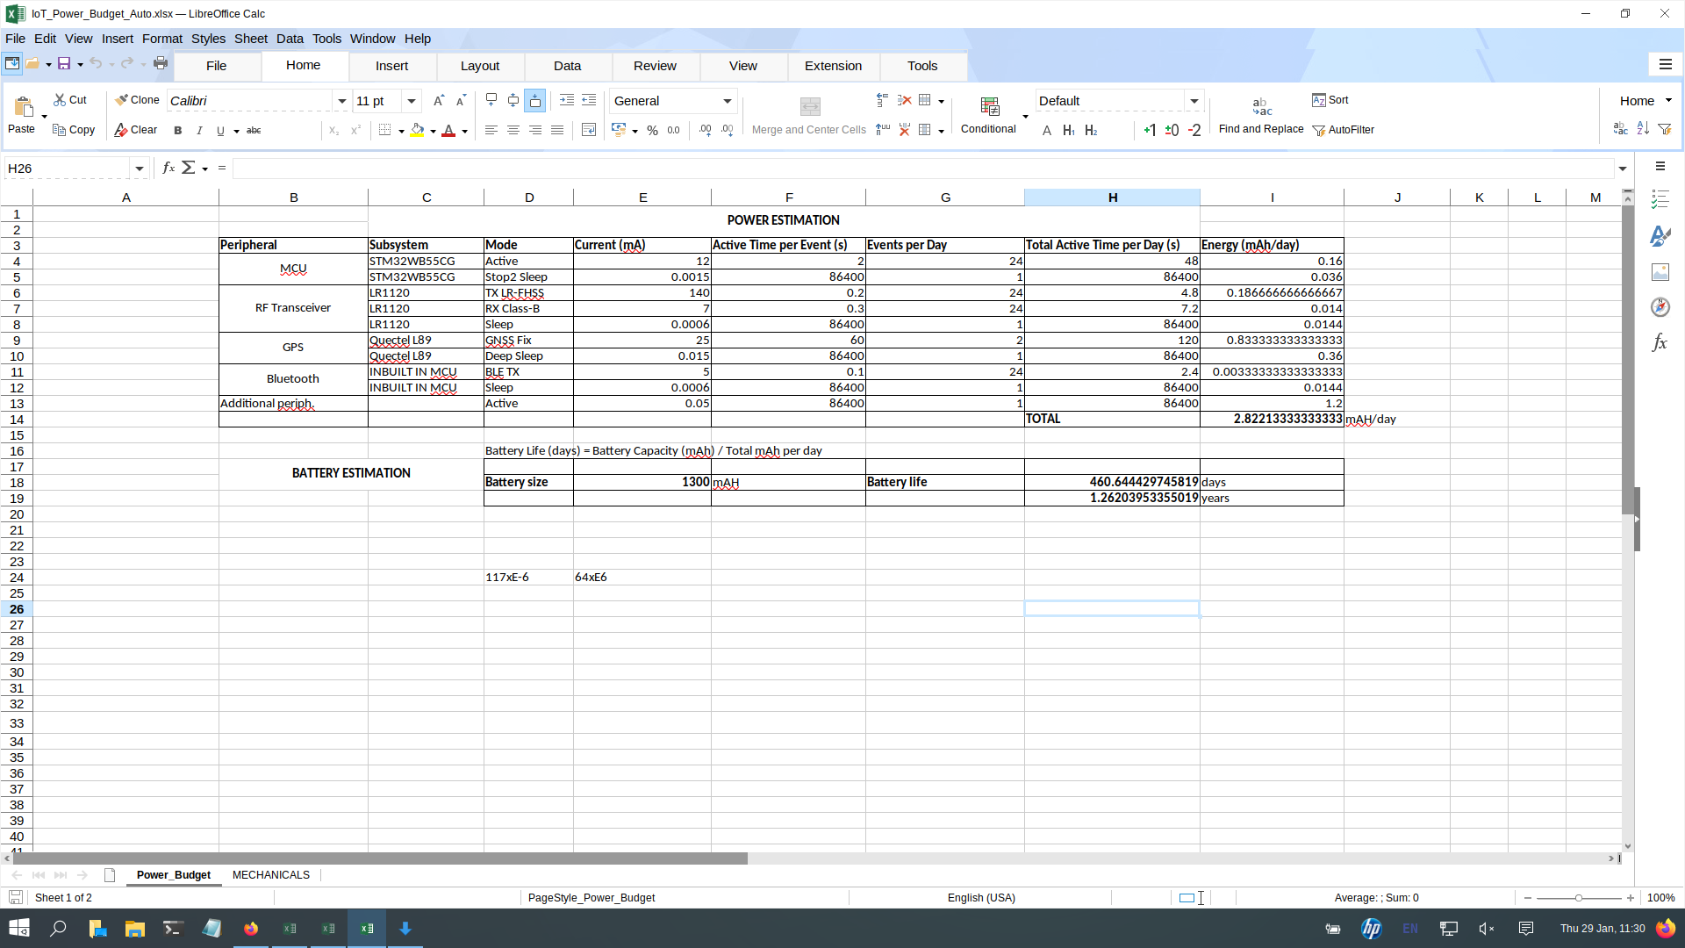
Power Consumption and Battery

Slide 7
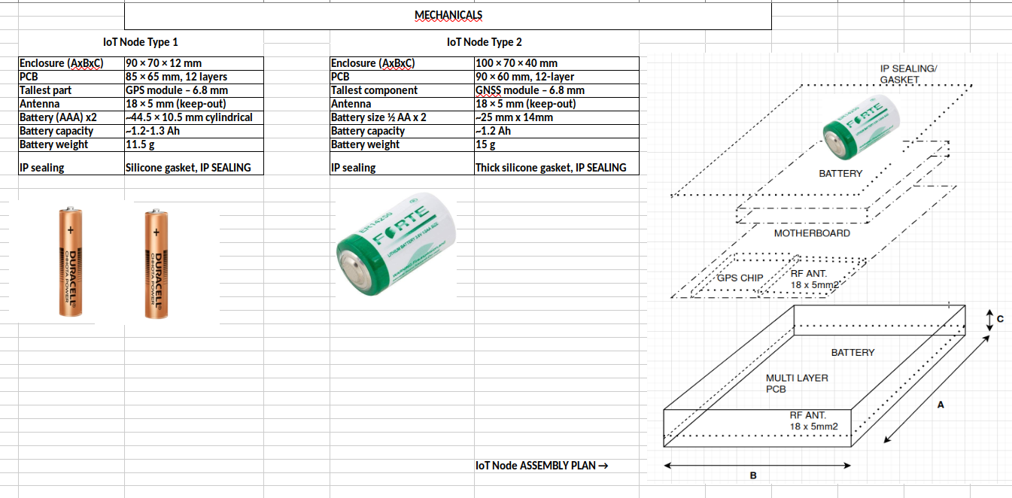
MECHANICALS AND FITMENT

